Slide 1
Welcome
Notes:
Slide 1
Welcome
My name is Bill McGowan

Slide 2
Campus Security Authorities
CSAs
Bill McGowan
Notes:
Slide 2
Today we will be discussing the Clery Act and more specifically we will be discussing the Campus Security Authorities who they are, and what they do.

Slide 3
Clery Act
Jeanne Clery Disclosure of Campus Security Policy and Campus Crime Statistics Act
Enacted in 1990, Federal Statute and enforced by the Department of Education.
Crime Awareness & Campus Security Act
Notes:
Slide 3
First want to talk a little about the clery act.
Sign in 1990, Federal Statute and enforced by the Department of Education

Slide 4
Clery Act
The law is named after Jeanne Clery, a 19 year old Lehigh University student who was raped and murdered in her campus residence hall in 1986.
JeaNne Clery
Campus Security Authority
Notes:
Slide 4
April 5th 1986. Jeanne Cleary, 19 year old student at Lehigh Univ, murdered by a fellow student at around 6am in her resident hall while she was sleeping. He had been out drinking all night, gained entry into her resident hall due to three security doors being propped open by pizza boxes. Her door was left unlocked because her roommate misplaced her key. Allegedly he went in to steal something, but when she woke up, he beat, raped, and eventually murdered her. He bragged about the incident to his friends and was subsequently arrested and convicted.
Connie and Howard Clery sent her to Lehigh Univ because they thought it was a safer school than Tulane where her brothers had attended college. They were not aware of all the recent crime activity on campus and felt the university did little about the recent crime and security to protect the students.

Slide 5
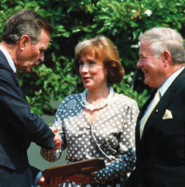
Clery Center
To work with college and university communities to create safer campuses.
http://clerycenter.org
Connie and Howard Clery
Notes:
Slide 5
They sued the college for 25 million dollars. They settled for an undisclosed amount of money. They used that money to start the Clery Center for Security on Campus. They did not stop there, they took their fight to Capitol Hill, until a law was passed in 1990, the Crime Awareness & Campus Security Act, later named the Jeanne Clery Act in 1991.

Slide 6
OCTOBER 1st
Institutions who receive federal funding must disseminate an annual security report by October 1st of each year.
NO EXCEPTIONS
Institutions should use their annual security report as an opportunity to powerfully communicate about all their campus safety and security efforts.
Notes:
Slide 8
Who knows what happens on :
October 1st
CLERY REPORT DUE
NO EXEPTION - NO EXTENTION - NO EXCUSE

Slide 7
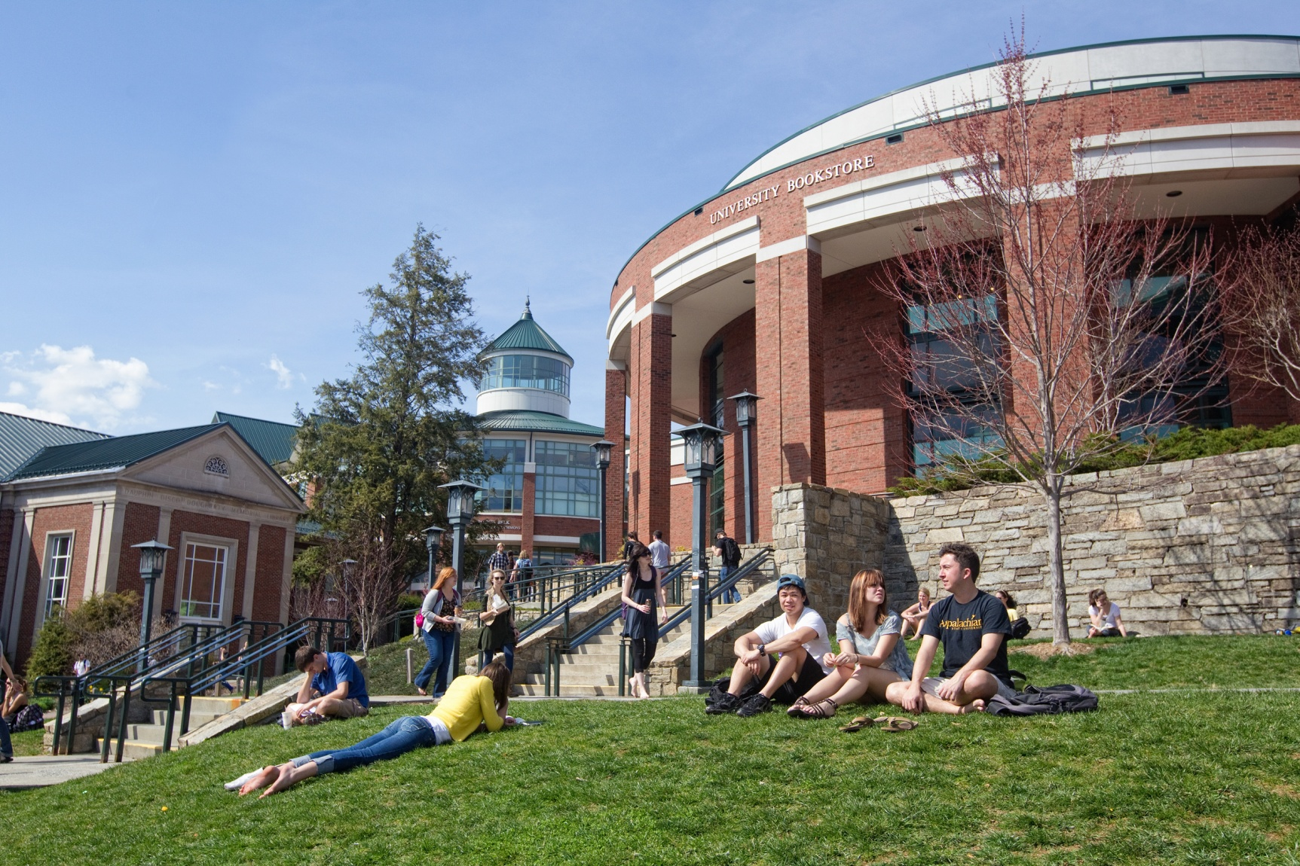
Who is a campus security Authority?
4 Groups on campus
Notes:
Slide 10

Slide 8
What is a CSA ? (Campus Security Authority) This is a Clery-specific term
“an official of the university who has significant responsibility for students and campus activities and has the duty to take action or respond to particular issues on behalf of the institution.”

Slide 9
Who are Campus Security authorities?
University Police Department
All individuals NOT employed by the University Police Department, but who have responsibility for campus security to include property security officers, parking enforcement and special event staff.
Individuals or offices designated to receive crime reports or take action on.
Dean of Students
Director of University Housing
Director of Student Conduct
Director of Title XI
Clery Act Compliance Coordinator
Office of Human Resources.
Notes:
Slide 25
University Police Department

Slide 10
Who are Campus Security Authorities?
University employees whose functions involve significant contact with students and those with significant responsibility for student and campus activity.
Includes but not limited to:
Chancellor and staff.
Vice President of Student affairs
Student Housing officials (RD-RA-GA-ResLife Staff)
Judicial Affairs & discipline
Athletic director and team coaches
Faculty advisors to student groups
Student health center director
Transportation Services
Military Science
Notes:
Slide 14
University employees whose functions involve significant contact with students and those with significant responsibility for student and campus activity.
(List)

Slide 11
What are the responsibilities of a
Campus Security Authority?
Notes:
Slide 18
In a nut shell

Slide 12
Campus Security Authorities What do I have to do?
If someone tells you about a crime, you must record the information and report it to the Appalachian State University Police Department or the designated reporting offices.
Obtain as much information as you can.
Who, what, when and where.
IF THE SUSPECT IS NOT IDENTIFIED - DO NOT ATTEMPT TO IDENTIFY!
Do not attempt to locate the suspect.
Notes:
Slide 31
CSAs What do they have to do?
Get the facts, Record and Report
Who, what, when, where.
If the suspect is not identified - do not attempt to identify!

Slide 13
EMERGENCY
If the crime is a violent crime in progress, creates a serious or on going threat to campus community or a Homicide :
Contact the police immediately.
9-1-1
Notes:
Slide 21
EMERGENCY - If the crime is a violent crime in progress, creates a serious or on going threat to campus community or a Homicide :
Contact the police immediately

Slide 14
Campus Security Authorities What do I have to do?
You do not have to prove if the information is true or not.
THE POLICE WILL CONDUCT THE INVESTIGATION.
Let the person know you must report the incident as a confidential statistic.
They can also report the incident directly to law enforcement.
Notes:
Slide 22
CSAs What do they have to do?
Do not have to prove the information is true or not.

Slide 15
So what happens if the university fails to comply with all the requirements of the Clery Act?
Notes:
Slide 29
What happens if the university fails to comply with all the requirements of the Clery Act?

Slide 16
Non-compliance of the clery ACT
Department of Education can issue fines up to $67,544.00 per violation of the Clery Act.
Notes:
Slide 30
Department of Education fines up to $35,000 .00 per violation.
A couple of years ago it was $27,500.00 but has increased.

Slide 17
Non-compliance of the clery ACT
Penn State was recently fined $2,397,500.00
As a result of the Department of Education audit / program review of their Clery Act and Drug Free Schools and Community Act.
This was a result of the Sandusky Case.

Slide 18
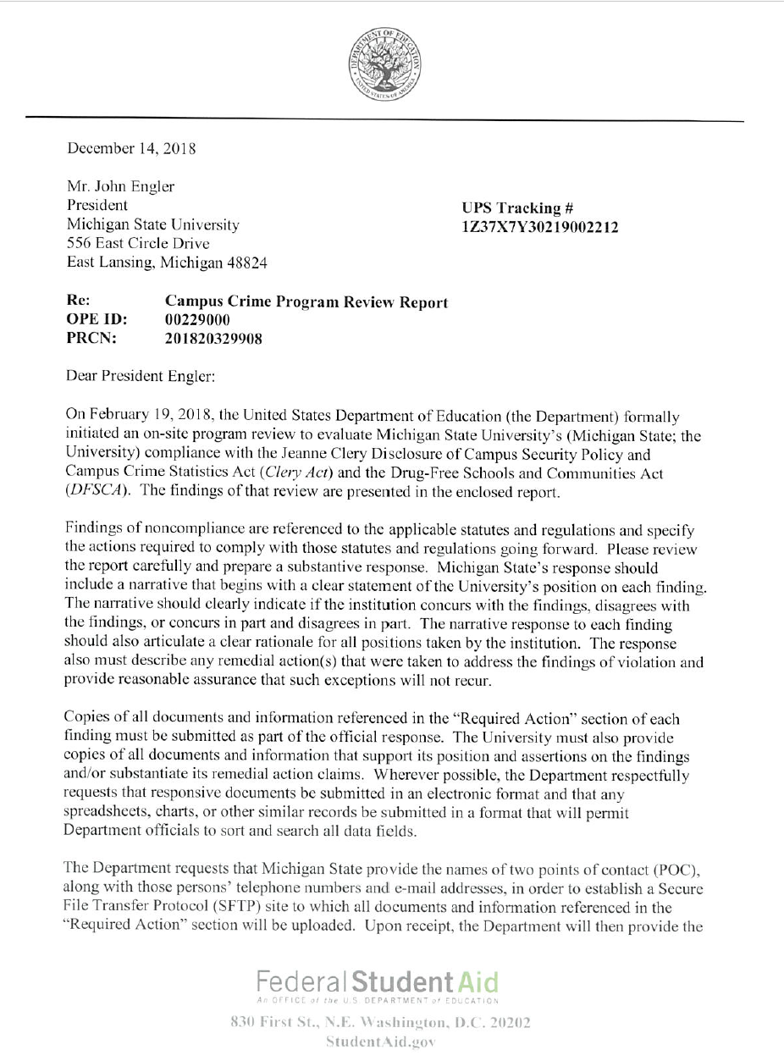
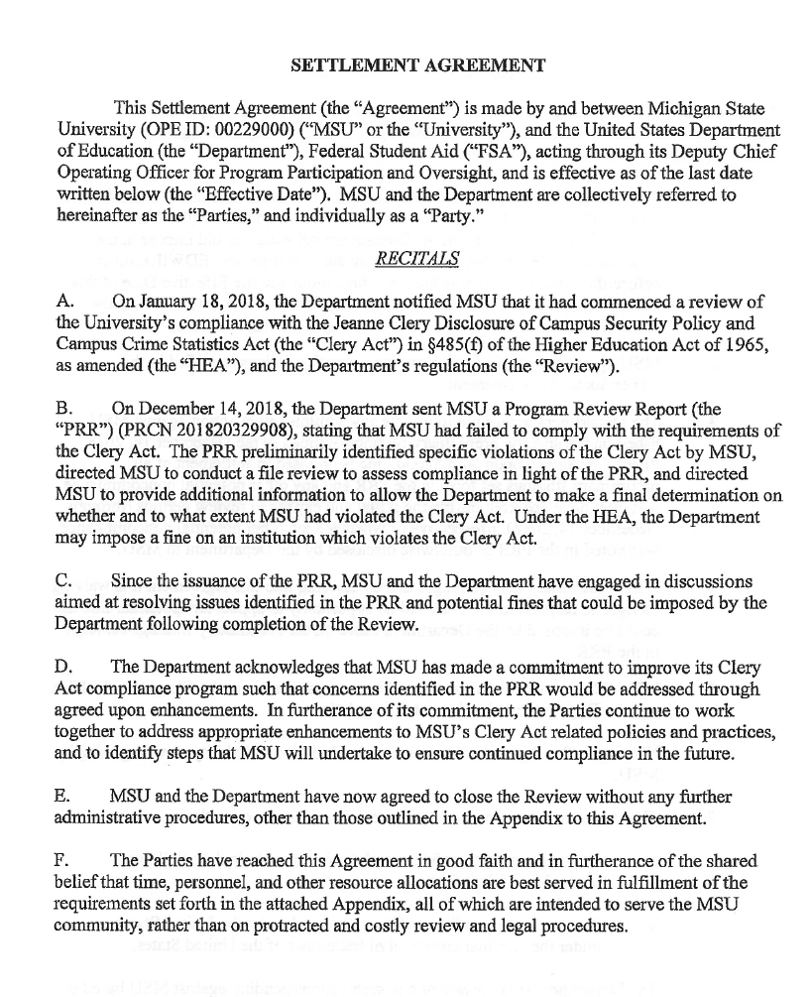
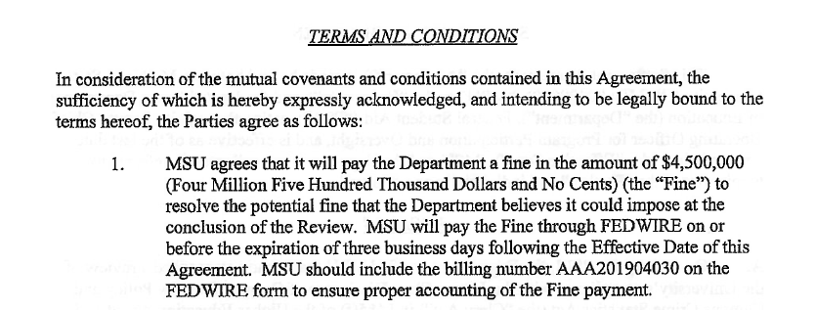
MICHIGAN STATE UNIVERSTY
$4,500,000.00

Slide 19
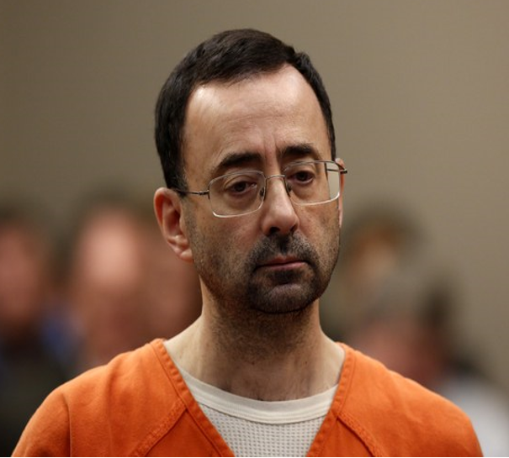
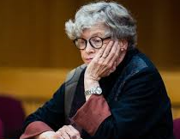
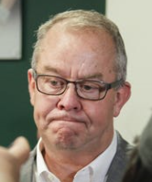
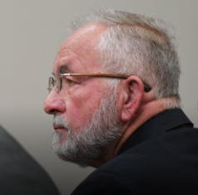
MSU makes $500 million settlement payment to survivor fund
MORE THAN 265 POSSIBLE VICTIMS
For almost 20 years, patients of Larry Nassar raised questions about whether his medical treatments were necessary and appropriate -- or a brazen form of sexual abuse.
Former MSU dean College of Osteopathic Medicine William Strampel sentenced to one year in jail stemming from the Nassar investigation
Simon is charged with felony and misdemeanor counts of lying to police. She could face up to four years in prison if convicted on the felony charges.
Larry Nassar: Former USA Gymnastics national team doctor and physician at Michigan State University.
40 to 175 years in prison
Michigan State athletic director Mark Hollis has stepped down Friday in the wake of the Larry Nassar scandal
MSU President Lou Ann K. Simon and Athletic Director Mark Hollis resigned in January amid allegations the university has mishandled allegations of sexual assaults.

Slide 20
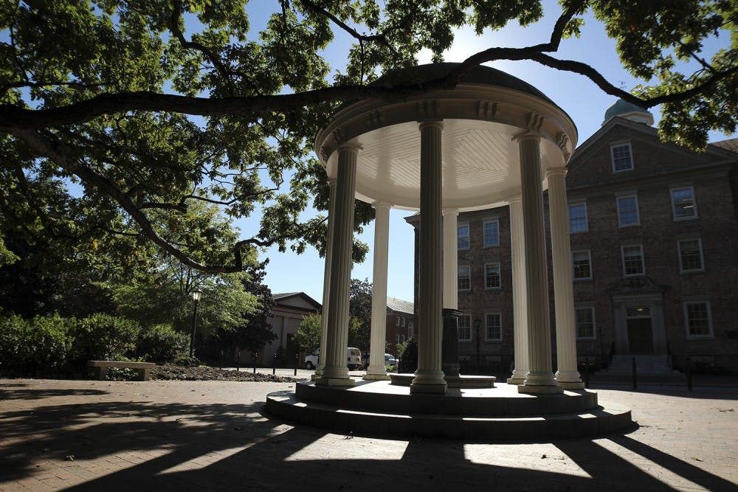
UNC ENTERS INTO $1.5 MILLION SETTLEMENT OVER CLERY ACT VIOLATIONS

Slide 21
Department of Education Program Review Fines
2008 – East Michigan University: $357,500.00
2010 – Liberty University: $165,000.00
2010 – Virginia Tech: $55,000.00
2011 – Yale University: $155,000.00
2011 – University of Vermont: $65,000.00
2012 – Joliet Junior College: $55,000.00
2012 – Dominican College of Blauvelt: $262,500.00
2013 – Cornell College: $55,000.00
2013 – Wards Corner Beauty Academy: $15,000.00
2014 – Midlands Technical College: $47,500.00
2014 – Sterling College: $165,000.00
2015 – Georgetown University: $155,000.00
2016 – Penn State University: $2,397,500.00
2017 – University of Montana: $966,614.00
2017 – Occidental College : $83,000.00
2017 – SC State University: $57,000.00
2017 –University of Jamestown: $210,000.00
2017 – University of St. Thomas: $172,000.00
2017 – Indian Hills Comm. College: $65,000.00
2017 – University of Scranton: $70,000.00
2017 – Virginia State University: $35,000.00
2018 – Green River College: $574,500.00
2018 – Concordia University : $68,000.00
2019 – Michigan State University: $4,500,000.00
2020 – UNC Chapel Hill: $1,500,000.00
2020 – UNC Berkeley: $2,350,000.00
2020 – Baylor University: $461,000.00
2020 – Auburn University: Pending

Slide 22
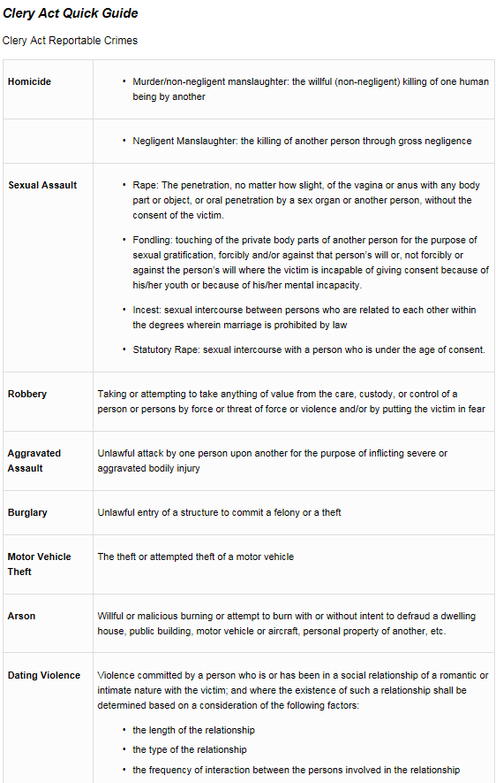
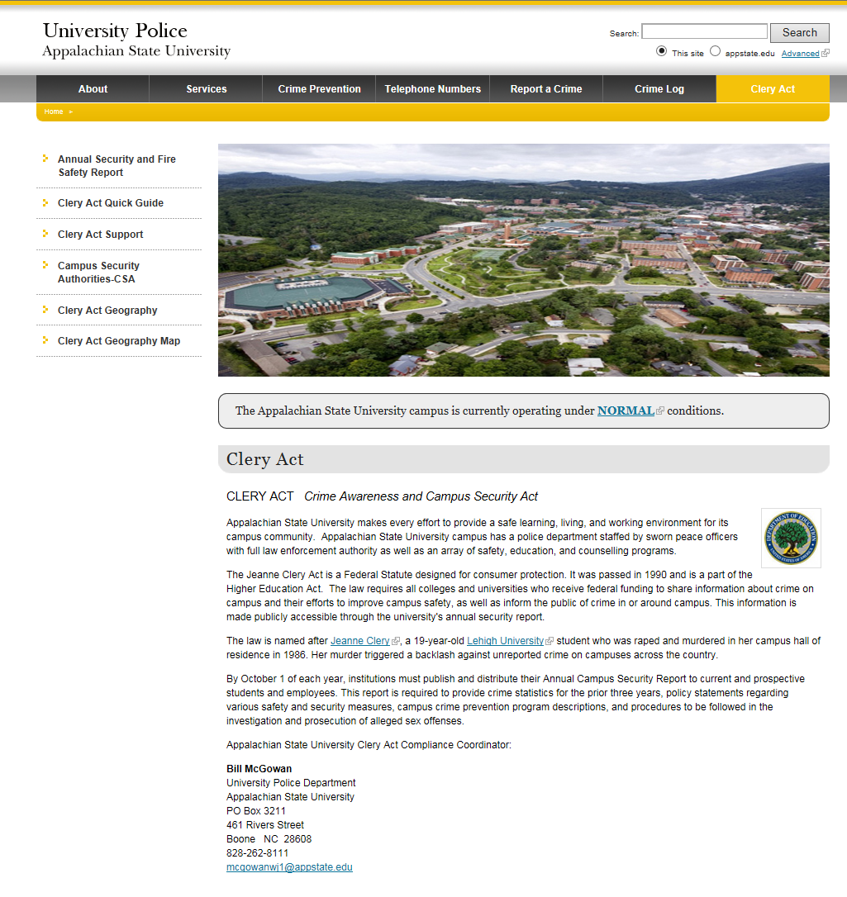
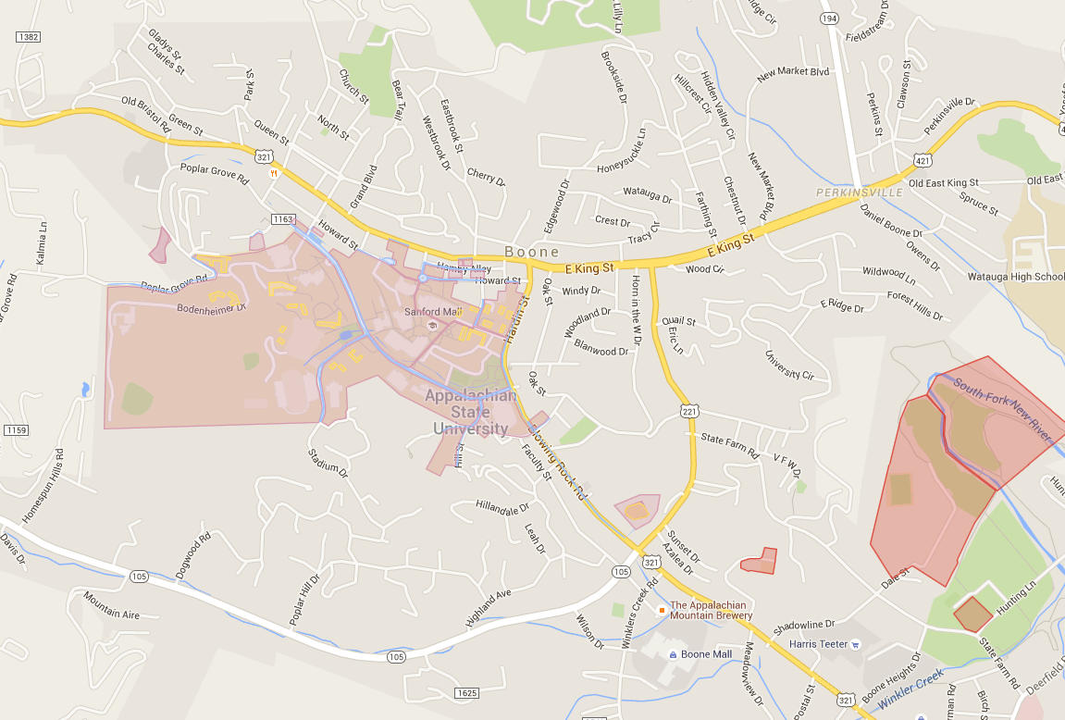
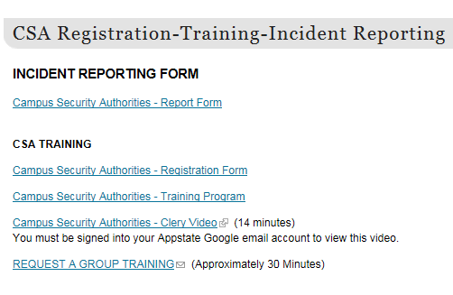

Slide 23
Help is always available
University Police Department
Located at the Rivers Street Parking Deck.
828-262-2150
Clery Compliance Coordinator
Bill McGowan
mcgowanwj1@appstate.edu
828-262-8111
Notes:
Slide 37
Help is always Available

Slide 24
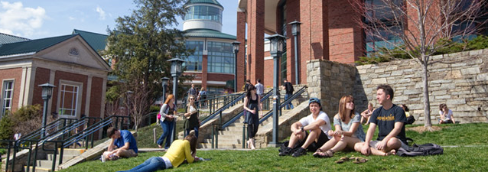
TEAM EFFORT
Through Partnerships, Education, & Awareness
It is everyone’s responsibility to provide a safe and healthy learning, living, and working environment on and around our campus community.
Campus Security Authority
Notes:
Slide 38
This is a Team Effort

Slide 25
Any Questions?
Campus Security Authority
Notes:
Slide 47
Thank you
THE END

Slide 26
Thank You
Campus Security Authority
Notes:
Slide 39
Thank you
THE END

